Slide 1
Compiler Construction Principles and Practice
How do computers understand and execute high-level languages?

Slide 2
Chapter 3 The foundation of automata
形式语言是编译的理论基础
形式语言是字母表中的符号按照一定的规则形成的符号串的集合。这个规则我们用文法来定义，本质上是用文法来定义语言。
文法分成了四类，语言对应也分成了四类，第四类文法为正规文法，第四类语言为正规语言。
多数语言的词法规则是用正规文法描述的。
我们不直接研究正规文法，而是研究与正规文法等价的有限自动机。
词法分析是通过有限自动机完成的。

Slide 3
Chapter 3 The foundation of automata
Automata is a model for languages and is also a tool for identifying languages.
Finite Automata (FA, 有限自动机) used to identify regular languages, which are useful in lexical analysis.
  3.1 Introduction to regular languages
  3.2 Definition and classification of FA
  3.3 Equivalent transformation of FA
  3.4 Implementation of FA
  3.5 Transformation of the three representations

Slide 4
3.1 Introduction to regular languages
【Definition】 Regular language is defined by regular grammar; lexemes in programming languages are regular.
  Regular grammar has three types of productions
(1) A -> aB (2) A -> a (3) A -> ε
  Three representation methods for regular languages:
  (1) Regular grammar (3) Finite automata
  (2) Regular expression
【E3.1】 G(Z)：A ->aA| ε
Regular grammar
∵ A=>ε ;
A=>aA=>aaA=>aaaA=>…=>a^{n} ,n≥0
∴ L(G)={ a^{n} | n≥0 }
Regular language

Slide 5
※ Examples
【E3.2】 L1 ={ a^{m}b^{n}| m≥0 ,n≥1 } , regular language? ∵It can be defined by regular grammar:
    G1(S): S -> aS|bA ; A -> bA|ε
∴ L1 is regular language.
【E3.3】 L2 ={(ab)^{n}| n≥1 } , regular language?
∵ It can be defined by regular grammar:
    G2(S): S -> aA ; A -> bB ; B -> aA|ε
∴ L2 is regular language.
【E3.4】 L3 ={a^{n}b^{n}| n≥0 } , regular language?
∵It can not be defined by regular grammar, which can not describe the number of a is equal to that of b.
∴ L3 is not regular language！

Slide 6
※ Two other representations for regular language
Ⅰ. Regular expression
Regular expression
L1= { a^{m}b^{n}| m≥0 ,n≥1 } ，
e1= a*b⁺
L2= {(ab)^{n}| n≥1 } ，
e2=(ab)⁺
L3= { ab^{n}c, b^{n} | n≥0 }，
e3= ab*c|b*
※ Regular expression is made of symbols in alphabet and the following three operators:
closure( *, + ) connection( . ) or( | )
※ Let val(e) be the value of e and L(e) be the language:
L(e)={ x| x=val(e)}
L(e) is the set of all values of e.

Slide 7
※ Two other representations for regular language
Ⅱ. Automata
FA1:
L1= { a^{m}b^{n}| m≥0 ,n≥1 }
a
b
b
① ②
+
-
L2= {(ab)^{n}|n≥1 }
a
b
① ② ③
L3= { ab^{n}c ,b^{n}|n≥0 }
+
-
a
FA3:
a
b
c
FA2:
+
③
①
②
-
-
b
b
④
-
※ It seems that FA is a directed graph with labels!

Slide 8
※ Notes on FA representation
b
a
c
L3={ ab^{n}c ,b^{n}|n≥0 }
+
③
①
②
-
-
b
b
④
-
  {1,2,3,4} — set of states;
  Where +(initial state)； -(final state)
  {a,b,c} — alphabet;
  δ(1,a)=2 — transition ( or );…
  (translate from state 1 to state 2 by accepting a);
a
①
②
【Mechanism】
Given an FA, if there is a path from initial state i to final state j, the symbol string on the path is denoted by α, α is a sentence;
All this kinds of α make up the language of the FA.

Slide 9
※ An example
【Example 3.5】 L ={ ab^{n}c, b^{n}| n≥0 },∑= {a,b,c}；
1. Regular grammar:
G(S): S-> aA|bB|ε ，A -> bA|c ，B -> bB| ε
2. Regular expression:
e = ab*c|b*
3. Finite Automata
b
a
c
+
③
①
②
-
-
b
b
④
-
【Notes】A language is regular if it can be defined by one of the three representations, otherwise not.

Slide 10
3.2 Definition and classification of FA
3.2.1 Definition of FA
【Definition】A FA can be used to describe regular languages, which is defined by 5-tuples:
FA=( Q , ∑ , S , F , δ )
where
Q (finite set of states) ;
∑(alphabet) ;
i , j∈Q, a∈∑+{ε};
S (set for initial states, S ⊆ Q) ;
F (set for final states, F ⊆ Q ) ;
δ transition
a
δ(i , a)= j
or
i
j
From state i to state j when reading a

Slide 11
3.2.2 Languages described by FA
Let L(FA) be the language described by FA,
x
L(FA)={ x| i j , x∈∑* ,i∈S,j∈F }
=>
if x=a₁ a₂…a_{n} ， a_{i}∈∑+{ε}
That is
a₁
a₂
a_{n}
即：
Then
i
=>
i₁
=>
i₂
…
=>
j
In a FA, there is a path from initial state i to final state j, and each edge of the transition (=>) compose a string x; we say x is accepted by FA.
For the FA in the right, the process of generating L(FA) is as following page:
b
a
c
+
③
①
②
-
-
b
b
④
-

Slide 12
※ The procedure of generating L(FA)
ⅠThe first path: FA1
b
a
c
a
c
+
③
①
②
-
+
①
=>
②
=>
③
-
b
b
a
b
c
④
①
=>
②
=>
②
=>
③
-
+
a
b
b
c
+
①
=>
②
=>
②
=>
②
=>
③
It can accept empty string!
…
ⅡThe second path：FA2
ε
∴ L(FA1)={ ab^{n}c| n≥0 }
+
①
=>
①
b
+
①
=>
④
∴ L(FA2)={ b^{n}| n≥0 }
b
b
+
①
=>
④
=>
④
…
∴ L(FA)={ab^{n}c, b^{n}| n≥0 }
Therefore,

Slide 13
3.2.3 Two representations for FA
【Example 3.6】FA=( Q,∑,S,F,δ )
where Q={1,2,3,4},∑={a,b,c}, S={1,2}, F={3,4}
δ ：δ(1,a)=2; δ(1,b)=4;δ(2,b)=2;
δ(2,c)=3; δ(2,ε)=3; δ(4,b)=4;
Initial states and
Final states
1.State transition graph
2.Transition table
b
a
b
c
ε
a
c
1
+
②
③
2
4
①
-
+
+
2
2
3
3
+
b
b
ε
3
-
④
-
-
4
4
For the transition table, row—states, column—symbols, item—states after transition
Notes:
变换表又称状态转换矩阵

Slide 14
3.2.4 Classifications of FA
【E 3.7】A={ ab^{n}c,(ab)^{n}|n≥0 }
Construct the FA.
b
a
Method 1
a
c
+
⑤
③
-
④
①
②
-
b
+
Method 2
b
c
？
a
b
c
+
a
③
①
②
+
③
-
①
②
a
-
-
a
-
a
Compare the three methods
【例3.7】构造正规语言
④
b
⑤
④
-
Method 3
b
b
1. Many initial states!
a
c
①
②
③
2. Many transition values
+
b
-
ε
a
-
④
⑤
e.g. δ(1,a)=(2|4)!
3. There are ε-edges.
How to improve them ?
Notes:
打叉的那个图的问题：它能够识别的语言与A不同，可以识别ababc这个句子

Slide 15
3.2.4 Classifications of FA
c
A={ ab^{n}c,(ab)^{n}|n≥0 }
a
b
+
b
b
c
⑤
-
①
②
③
④
-
-
※ Deterministic finite automata
a
c
a
DFA:
⑥
b
⑦
-
【 Classification】
1. Deterministic Finite Automata (DFA)
(1) one initial state; (2) one transition value; (3) no ε edges
2. Non-deterministic Finite Automata (NFA)
-- FA, but not DFA！
(1) (εNFA) NFA contains ε edges
ε
(2) ( NFA) NFA does not contain ε edges

Slide 16
3.3 Equivalent transformation of FA
※ Equivalent transformation
(1) NFA=>DFA
NFA, easy to construct, hard to use
DFA, difficult to construct, easy to use
Any NFA can be transformed to its equivalent DFA by some algorithms. Both NFA and DFA can represent regular languages.
(2) DFA=>Minimized DFA
Minimizing DFA is also called simplifying DFA
Given DFA1, construct an equivalent DFA2, e.g.
L(DFA1)=L(DFA2); DFA2 has smallest states.

Slide 17
3.3.1 Equivalence of FA
Ⅰ. Equivalence of two FAs
【Def.1】Given FA1 and FA2, FA1 is equivalent to FA2 iff L(FA1)= L(FA2), denoted by FA1≡FA2
b
※Four paths can be accept.
FA1
a
b
①
②
③
ab⁺ , ab* , b⁺ , ε
ε
ε
-
+
L(FA1)={ab^{n},b^{n}|n≥0}
FA2
a
b
※Four paths can be accept.
+
b
①
②
③
ab* , b⁺ , ε
-
-
-
-
b
L(FA2)={ab^{n},b^{n}|n≥0}
∵ L(FA1)=L(FA2)
∴ FA1≡FA2

Slide 18
3.3.1 Equivalence of FA
Ⅱ.Equivalence of two states
【Def.2】Given two states i and j in an FA, i ≡ j iff i and j can accept same string set as if i and j are initial states.
ε
Example1
FA1:
b
b
a
c
a
①
②
③
①
②
+
-
+
-
ε
c
∵ Node 2,3 have an ε cycle ∴2 and 3 are equivalent
Example 2 FA2:
②
a
a
Identify equivalence
③
ε
-
a
4≡5 ？
×
3≡5 ？
b
√
④
⑤
-
2≡3 ？
×
2≡4 ？
×
【Notes】How to identify equivalence of states?
Notes:
4能接受b，2不能接受b

Slide 19
3.3.2 有限自动机的确定化算法
NFA=>DFA
ε
NFA
Ⅰ. 消除 ε 边算法( εNFA => )
Ⅱ.把 化为DFA算法( =>DFA )
ε
ε
NFA
NFA

Slide 20
3.3.2 有限自动机的确定化算法
Ⅰ. 消除 ε 边算法( εNFA => 或DFA )
ε
NFA
(1) 若存在ε闭路，则把ε闭路上各节点合而为一：
ε
③
a
b
b
ε
a
②
c
②
-
ε
④
-
c
(2) 标记隐含的开始态和结束态：
ε
c
-
b
b
+
开始态的ε通路上的节点：+
①
②
③
-
+
ε
+
ε
结束态逆向ε通路上节点：-
ε
b
(3) 对ε边，按ε通路逆向逐一进行：
a
b
②
③
c
① 删除一个ε边；同时
c
⑤
② 引进新边 ：
凡由原ε边终点发出的边，也要由其始点发出。
(4) 重复步骤(3)，直到再无ε边为止。

Slide 21
3.3.2 有限自动机的确定化算法
NFA=>DFA
ε
NFA
Ⅰ. 消除 ε 边算法( εNFA => )
Ⅱ.把 化为DFA算法( =>DFA )
ε
ε
NFA
NFA
ε
ε
①
②
③
ε
ε
①
②
③
a

Slide 22
※ 消除ε边算法示例：
ε
ε
【例3.8】考查εNFA：
a
b
c
④
①
②
③
-
L(εNFA)= ?
+
ε
ε
(1) ε闭路上的节点等价（ ）,可合而为一；
①
≡
②
(2) 标记隐含的开始态和结束态：
②
ε
，
③
-
+
，
+
④
a
b
c
+
②
③
④
(3) 逆序逐一删除ε边，同时引进新边：
-
-
+
+
ε
ε
NFA
ε
c
c
c
a
c
a
c
b
+
b
④
+
③
④
③
①
-
-
①
-
-
+
+
+
+
∴ { a^{m},a^{m}bc^{n}, a^{m}c^{n}|m≥0,n≥1 }
L( )=
ε
NFA

Slide 23
3.3.2 有限自动机的确定化算法(续1)
ε
NFA
ε
NFA
Ⅱ.把 化为DFA算法( =>DFA )
字母表中符号
(1) 构造DFA的变换表(框架)：
a₁
a₂
a₃
…
开始态集
ε
NFA
{q₀¹,…q₀^{n}}
{ … }
(2) 按 的变换函数实施变换：
ε
NFA
δ({q_{i}¹,…q_{i}^{n} } ,a_{k})= δ(q_{i}¹, a_{k})∪… ∪ δ(q_{i}^{n}, a_{k})={q_{j}¹,…q_{j}^{n}}
(3) 若{q_{j}¹,…q_{j}^{n}} 未作为状态行标记，则作新行标记；
(4) 重复步骤(2)(3)，直到不再出现新状态集为止；
(5) 标记DFA的开始态和结束态：
第一行{q₀¹,…q₀^{n}}，(右侧)标记 + ；
凡是状态行中含有 的结束状态者，(右侧)标记-
ε
NFA
【注】必要时，新产生的DFA可用状态图表示。

Slide 24
※ 确定化示例：
ε
NFA
【例3.9】联合式自动机NFA:
b
a
a
c
+
⑤
③
-
④
①
②
-
b
+
※ 确定化过程:
DFA:
a
b
c
a
+
A{1,4}
B{2,5}
-
B{2,5}
C{2,4}
D{3}
E
G
-
b
-
C{2,4}
E{5}
F{2}
D{3}
a
b
-
D{3}
b
-
C
F
E{5}
G{4}
c
b
c
F{2}
F{2}
D{3}
a
c
-
G{4}
E{5}
+
A
B
D
-
-
【注】A,B,C,… 状态集的代码

Slide 25
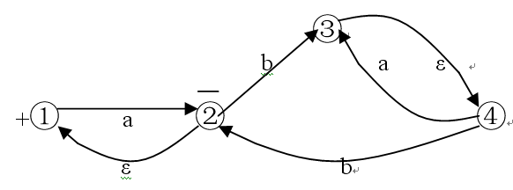
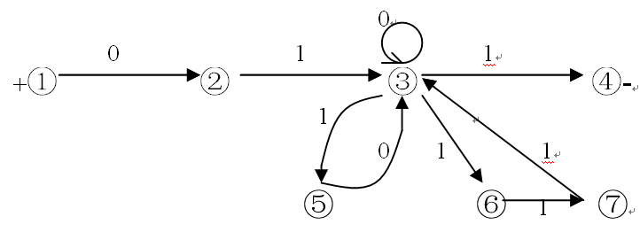
※NFA确定化练习
1. 消除 ε 边练习
ε
NFA
2. 确定化练习

Slide 26
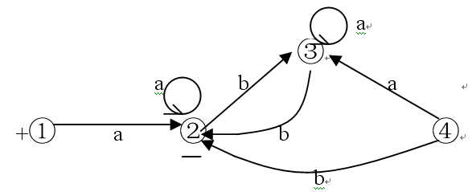
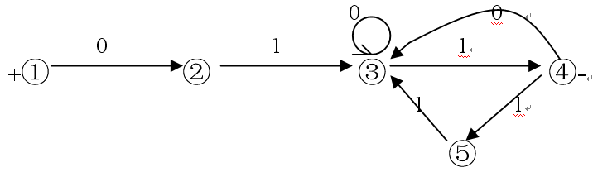
※NFA确定化练习
1. 消除 ε 边练习的答案
ε
NFA
2. 确定化练习的答案

Slide 27
3.3.3 Minimization of DFA
Minimized DFA must satisfy:
(1) No useless states;
(2) No equivalent states;
Ⅰ. Delete useless states
【Def】 Useless state is the states can not reach from initial state by any legal string.
【Algorithm】 Construct useful state set Q_{us}
(1) 设 q₀ 为开始态，则 令 q₀∈Q_{us} ；
(2) 若 q_{i}∈Q_{us} 且有 δ(q_{i},a)= q_{j} 则令 q_{j}∈Q_{us} ；
(3) 重复执行(2)，直到Q_{us}不再增大为止。
(4) 从状态集Q中，删除不在Q_{us}中的所有状态。
Notes:
构造有用状态集 Qus

Slide 28
3.3.3 Minimization of DFA
Ⅱ. Algorithm for merging equivalent states
【Def.】Equivalence of two states i and j
① Both of them are final states, or both of them are not;
② For each symbol, i and j transit to equivalent states.
Example: Minimize the DFA in right Fig.
a
a
+
②
-
-
①
(1) 初分成两个不等价子集：
b
a
b
Q₁={1,2},Q₂={3}
③
(2) 还能分成不等价子集吗？
a
b
∵ δ(1,a)= 2 , δ(2,a)= 2
δ(1,b)= 3 , δ(2,b)= 3
+
①
③
Minimized DFA
-
a
∴ 1≡2

Slide 29
3.3.3 Minimization of DFA
Ⅱ. Algorithm for merging equivalent states
---To divide non-equivalent states
(1) 初始，把状态集Q划分成两个不等价子集:
Q₁(结束状态集)， Q₂(非结束状态集)；
(2) 把每个Q_{i}再划分成不同的子集，条件是：
对同一Q_{i}中两个状态 i 和 j ，若对字母表中的某个符号，变换到最新已划分的不同的状态集中，则 i 和 j 应分离，即
如 δ(i,a)∈Q_{m} , δ(j,a)∈Q_{n} 且 m≠n
(3) 重复步骤(2)，直到再不能划分为止；
(4) 合并最终划分的每个子集中的各状态(合而为一)。

Slide 30
※ Example of DFA minimization
【Example 3.10】 Minimize DFA:
Transition table
-
a
b
a
b
⑤
+
a
1
6
3
b
b
a
3
1
5
+
①
③
b
②
⑦
-
a
6
4
-
b
a
a
⑧
⑥
④
5
7
3
-
a
-
b
a
4
4
6
7
4
-
(1) Delete useless states
Construct transition table dynamically:
It begins from state 1, successors are added in new lines until states do not increase. States do not in the table are useless.
【Note】 States 2 and 8 are deleted!
Notes:
实际是删除只有出没有进的状态

Slide 31
②
a
a
③
-
a
b
④
⑤
-
-
a
b
⑤
a
b
b
a
+
①
③
b
②
⑦
-
b
a
⑨
a
a
⑧
⑥
④
a
-
b
a

Slide 32
※ Example of DFA minimization
Non-equivalent set
(2) Merge equivalent states
DFA:
a
b
① Let Q_{NE}= { {1,3,4}, {5,6,7} }
+
1
6
3
② Consider {1,3,4} :
3
1
5
-
6
4
∵ δ(1,a)=6 ,δ({3,4},a)={1,4}
-
5
7
3
∴ Divide to Q₁={1}, Q₂={3,4}
4
4
6
So Q_{NE}= { {1},{3,4}, {5,6,7} }
-
7
4
③ Consider {3,4 } ∵ δ(3,a)=1 ,δ(4,a)=4
∴ Q₁={3}, Q₂={4}
Q_{NE}= { {1},{3},{4}, {5,6,7} }
④ For {5,6,7}: we can get Q₁={5}, Q₂={6,7}；
To sum up, Q_{NE}= { {1},{3},{4}, {5},{6,7} }

Slide 33
※ Example of DFA minimization
DFA:
a
b
a
b
Merge states: {6 , 7}
+
1
6
3
6
+
1
3
3
1
5
3
1
5
-
6
4
replace 7 by 6
6
4
-
-
5
7
3
5
6
3
-
4
4
6
4
4
6
-
7
4
a
b
The minimized
DFA !
b
⑤
-
+
①
③
b
a
a
a
⑥
④
-
b
a

Slide 34
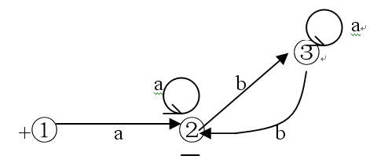
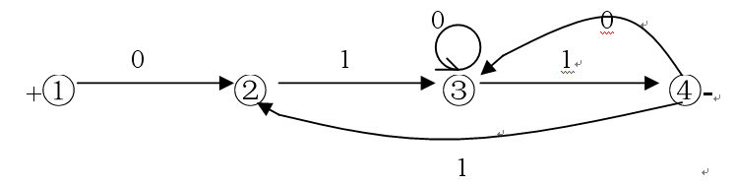
※ Practices

Slide 35
3.4 Implementation of DFA
To implement a DFA on computer systems, the core part is transition on states. We use transition table to store transition functions, and perform state transition by it.
Controller Table
【Remarks】
+
(1) FA reads symbols to identify whether the string is legal
and answer accept or reject.
(2) ‘ #’ is added to the end of the string
FA is extended to:
a
b
…
#
a
#
1
3
6
+
+
①
③
⑤
-
-
…
…
…
…
…
b
#
4
ok
-
⑥
④
-
5
ok
-
(3) getchar(ch) reads a symbol
Empty is reject

Slide 36
3.4.1 The controller
Initial states
开始
state = 1
getchar(ch)
Read a symbol from input string and assign to ch
查变换表： δ(state,ch)= ?
y
δ=空
state = δ
n
reject
n
δ=ok
y
accept
Assign translated state δ to variable state.
结束
Notes:
在变换表中查找，如果变换以后的状态是ε，回答否，然后结束，否则，如果是OK，回答是，结束，否则，继续用变换后的状态和输入的符号来查变换表
变量 state 重新被赋值为变换后的状态！

Slide 37
3.4.2 The structure of transition table
We have two methods to store data.
(1) Two-dimensional array, (state,symbol)；
※ We should encode the states in the FA with integer 1,2,3,…
※ The content in the item of the table is the state number to transit.
(2) Compressed table, we do not record empty transitions.
Index
a
⑤
Sub-table
b
⑧
e
④
state
①
…
f
②
②
no
…
x
①
∀
…
…
∀
no
y
⑨
n
…
∀(others)—error!
∀
no

Slide 38
※An example of DFA implementation
【Example 3.11】 Given a DFA:
a
③
Index
b
②
a
∀
no
a
b
#
①
+
①
③
④
d
④
c
-
②
b
d
∀
no
②
③
a
③
Identifying string aacd#
④
b
④
c
②
state
ch
Remain
Tran
∀
no
1
a
acd#
3
#
ok
3
a
cd#
3
∀
no
3
c
d#
2
2
d
#
4
Transitions
4
#
ok
accept
Notes:
S->aC|bB
C->aC|cB
B->d
以上识别过程实际就是：
S=>aC=>aaC=>aacB=>aacd

Slide 39

Regular grammar <=> DFA
Regular expression

Slide 40
3.5 Transformation of the three representations
  The three representations for regular languages:
(1) regular grammar (2) regular expression (3) FA
Based on FA, we introduce the following transformations
Ⅰ. Regular grammar <=> DFA
Given G(Z)=(V_{N},V_{T},Z,P), DFA=(Q,∑,S,F,δ)
We have:
Regular grammar
DFA
V_{N}
Q
V_{T}
∑
Z(initial symbol)
S(initial state)
A -> aB
δ(A,a)=B
A -> a
δ(A,a)=C(final state)
A -> ε
A(final state)
Sometimes need an additional state
Notes:
若δ(A,a)=B(结束态)，将规则A->aB|a或A->aB,B-> ε加入到P中

Slide 41
※ Transformation between regular grammar and DFA
【Example 3.12】 FA => regular grammar
DFA:
b
令 Z-①, A-②, B-③
a
d
①
②
③
+
c
-
So we have:
G(Z):
Z->aA|cB , A->bA|dB , B->ε
【 Example 3.13】 regular grammar => FA
G(Z): Z->aZ|bA|ε, A->bA|d
The DFA
∵ A->d ➔A->dB,B->ε
a
b
∴ G`(Z) (equal to G(Z)):
+
b
d
Z->aZ|bA|ε, A->bA|dB, B->ε
-
①
②
③
-
令 ①-Z, ②-A, ③-B
则 L(G)={a^{m},a^{m}b^{n}d|m≥0,n>0}
Notes:
实际上就是引入结束状态B

Slide 42
3.5 Transformation of the three representations
Ⅱ. Regular expression <=> DFA
Initial state
Let e be a regular expression , DFA=(Q,∑,S,F,δ)
e
Final state
Methods：
e
<=>
s
f
+
-
※ e => DFA by decomposition； DFA => e by composition
e₁
so：
e₁|e₂
decomposition
i
j
i
e₂
j
composition
e₁.e₂
e₁
e₂
i
j
i
k
j
We can use one of them:
e
e*
i
j
ε
ε
i
k
j
e
e
e
e
ε
ε
i
j
or
i
j
or
i
or
j

Slide 43
3.5 Transformation of the three representations
a
【3.14】 Regular expression => FA
Ⅳ
a
②
b
Let e=a*b|bc*
①
b
+
⑨
+
ε
-
so：
b
Ⅰ
a*b
-
③
Ⅲ
a
c
①
bc*
⑨
ε
b
+
-
②
①
b
+
ε
⑨
Ⅴ
a
+
-
Ⅱ
a*
b
③
a
②
-
c
②
b
+
①
b
c*
⑨
①
b
+
⑨
-
+
-
③
determinate
b
-
Ⅵ
③
c
a
b
c
+
A{1,2}
B{2}
C{3,9}
DFA:
a
B{2}
B{2}
D{9}
a
b
B
D
-
-
C{3,9}
E{3}
+
A
b
c
c
-
D{9}
C
E
-
-
-
E{3}
E{3}
equivalent

Slide 44
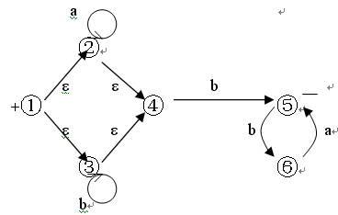
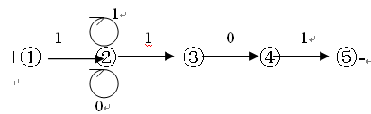
※ Practices
1. (a*|b*)b(ba)*
2. 1(0|1)*101

Slide 45
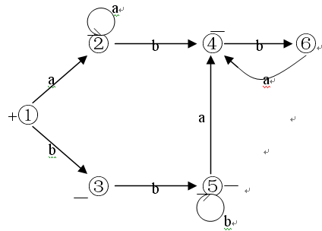
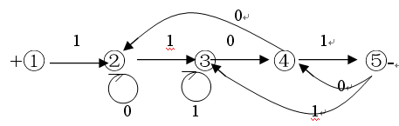
※ Practices
1. (a*|b*)b(ba)* to DFA
2. 1(0|1)*101 to DFA

